Slide 1
Performance of VoIP in a 802.11 Wireless Mesh Networks by D. Niculescu, S. Ganguly, K. Kim and R. Izmailov
Infocom 2006
Myungchul Kim
mck@kaist.ac.kr

Slide 2
Abstract
Performance in multihop wireless networks is known to degrade with the number of hops.
How to improve voice quality?

Slide 3
Introduction
The success of the Skype service
  Cost saving and easy deployment
VoIP over WLAN
  dual cellular phone handset with WiFi capabilities
WMN over wired LAN connecting WiFi
  Easy of deployment and expansion
  Better coverage
  Resilience to node failure
  Reduced cost of maintenance
Issues in voice service over WMN
  In a single channel, UDP throughput decreases
  Interference
  High overhead of the protocol stack

Slide 4
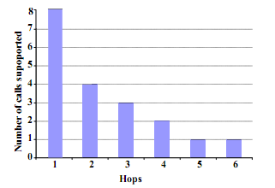
Fig 1
With 2Mbps link speed, 8 calls in single hop to one call after 5 hops due to the following:
  Decrease in the UDP throughput because of self interference
  Packet loss over multiple hops
  High protocol overhead for small VoIP packets

Slide 5
Focus on two problems supporting VoIP over WMN
  Increase VoIP capacity
    Use of multiple interface
    Efficient routing
    Use of multihop packet aggregation to reduce overhead
  Maintain QoS under internal and external interference
Related work
  VoIP requires 200ms or less one way delay
  VoIP over 802.11
  Dual queue of 802.11 MAC to provide priority to VoIP
  Packet aggregation to increase capacity

Slide 6
VoIP Basics
A VoIP system = an encoder-decoder pair and an IP transport network
G.729
  A voice encoder
  10ms or 20ms frames
  50 packets per second of 20 bytes each
  No consideration of silence periods
R-score [15]
  Metric for quality of VoIP
  Mouth to ear delay, loss rate and the type of the encoder
  For medium quality, above 70

Slide 7
R = 94.2 − 0.024d
− 0.11(d − 177.3)H(d − 177.3)
− 11 − 40log(1 + 10e)
Where:
• d = 25 + d_{jitter_buffer} + d_{network} is the total ear to mouth delay comprising 25 ms vocoder delay, delay in the de-jitter buffer, and network delay
• e = e_{network} + (1 − e_{network})e_{jitter} is the total loss including network and jitter losses
• H(x) = 1 if x > 0; 0 otherwise is the Heaviside function
• the parameters used are specific to the G.729a encoder with uniformly distributed loss

Slide 8
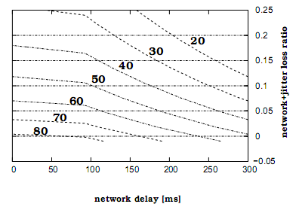
Fig 2.
  For 60ms jitter buffer and 25ms vocoder delay
  Jitter buffer?
  Loss has a high variance?
  End to end loss needs to be maintained under 2%

Slide 9
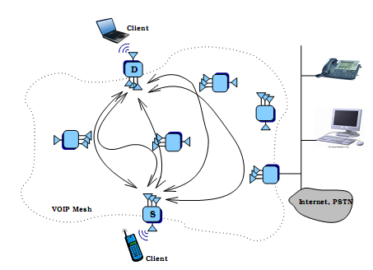
VoIP Mesh System
One interface in ad hoc mode for the backhaul in the mesh
Another interface in infrastructure mode to connect to clients
Fig 3

Slide 10
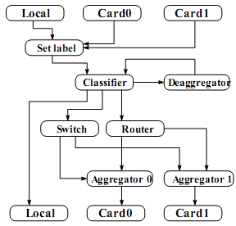
Mesh node
  Each node with two 802.11b at the fixed rate of 2Mbps
  Packet aggregation: encapsulates multiple small VoIP packets into larger packets and forwards it
Fig 5

Slide 11
VoIP call routing
  Hard deadline of about 200ms mouth to ear
  Multipath routing: several alternative paths between the same source destination pair, available all times
  Up to five pre-computed paths are maintained for all voice communications of a pair of nodes: for mobility, QoS, fast call admission

Slide 12
VoIP performance optimizations
Evaluation methodology
  Rude UDP
  CBR packet flows
  G729 encoder producing 50 packets per second with 20 bytes of payload each for one minute
Use of multiple interfaces
  Three independent channels for 802.11b
  Eleven independent channels for 802.11a but shorter transmission range

Slide 13
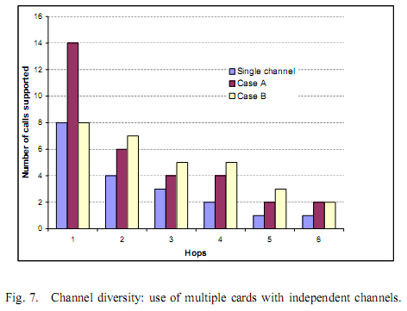
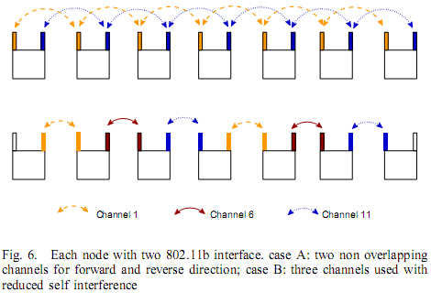
  Figs 6 and 7

Slide 14
Routing
  A good route depends
    Channel quality
    Dynamic condition due to interference
    Traffic load
    Voice quality: changes in routes, call admission and handoff
  Voice call routing approach: route discovery and adaptive path selection
  Route discovery
    Options:
      DSR and maintain multiple source destination paths
      DSDV: frequently updating paths in the middle of the call
    The metrics (loss based such as ETX) provide unacceptable performance

Slide 15
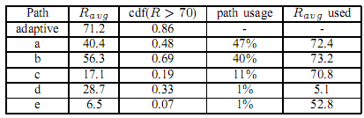
  Adaptive path selection
    Monitors all the paths
    When the R-score stays under 70, switch to another path
  Table I (Third column: the fraction of time when R > 70)

Slide 16
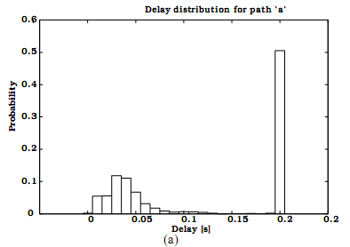
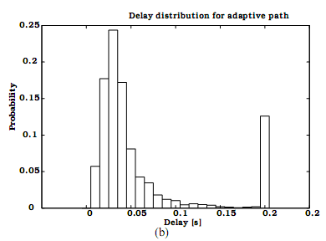
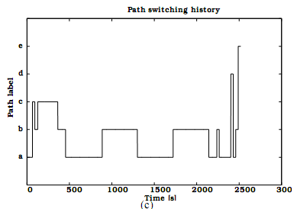
  R-score: loss or delay?
  The measured path delay 8-15ms
  Why 200ms?

Slide 17
Aggregation
  802.11 networks incur a high overhead to transfer one packet
  For a 20 byte VoIP payload
    Related protocols = 43.6 microsec at 11 Mbps
      - RTP/UDP/IP 12+8+20 = 40 bytes
      - MAC header + ACK = 38 bytes
    MAC/PHY procedure overhead = 754 microsec
      DIFS(50microsec), SIFS(10microsec)
      Preamble + PLCP(192microsec) for data and ACK
      Contention (approx 310microsec)
    800 microsec at 11 Mbps -> 1250 packets per sec -> G.729a (1 call with 10 ms = 100 packets): 12 calls (2Mbps -> 8 calls)
    Throughput: T(x) = 8x / (754 + (78 + x) 8/B)) where x is the payload size in bytes and B is the raw bandwidth of the channel

Slide 18
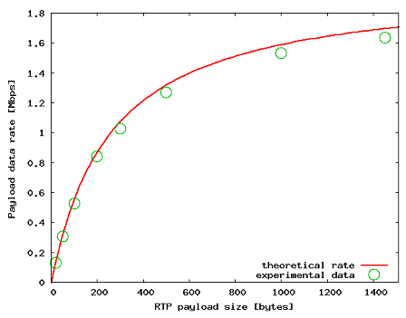
  The capacity of the network is only 10% of the max possible.
  Fig 11

Slide 19
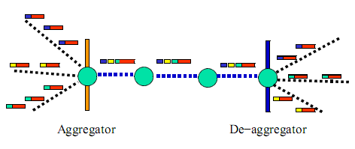
  Reducing the overhead
    Aggregation (Fig 12) -> increase packet delay
    Header compression
  Fig 12

Slide 20
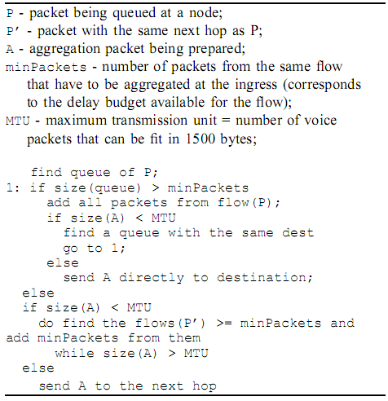
  Algorithm 1: aggregation logic for ingress node

Slide 21
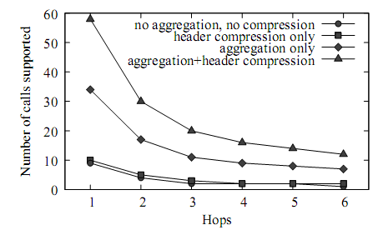
Aggregation and header compression
  Fig 17

Slide 22
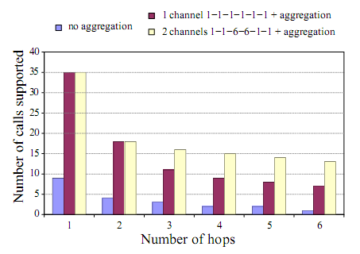
Aggregation and multiple interfaces
  Fig 18

